Slide 1
CAPSTONE PROJECT
Financial Indicators of US stocks
Cohort B Team 1:
Xiaoqi Hu, Yanni Lan, Chenhang Niu, Yuyang Shu, Siqi Zhang

Slide 2
TABLE OF CONTENTS
01
04
02
05
03
06
About the Project
Data Cleaning
Background Information and Project Goal
Data Sorting and Cleaning
Project Stages
Exploratory Analysis
Working logic and main method
Trends Inside and Correlation
Data Introduction
Challenges and Concerns
Dataset Size and Variables
What we hope to fix in the future analysis

Slide 3
ABOUT THE PROJECT
In FinTech Industry, algorithmic trading strategies are expanding with new methods. Many IPO companies have spend money in infrastures and R&D to gain more capital from the stock Market.
In this project, we are going to looking at the Financial Indicators, which mostly from the company’s financial reports to evaluate the stock performance, and help stakeholders and investors be more aware about financial indicators when they are making the investor..
Notes:
Our team are interested in Fintech and trading algorithm, so we find this related project to work on. Especially, we have a very volatility week. Lots of company lease their company's quarterly reports, hope you guys have tesla and amazon stock in hand.

Slide 4
PROJECT STAGES
01. Exploration
03. ML Modeling
Find Correlations between Financial Indicators and find related variables
Fit the data into different supervised machine learning model
02. Component Reduction
04. Business Application
Eliminate some indicators through component reduction, then run the model again for the stock price prediction
Present our best model and its accuracy of the stock value prediction. Helping with trading algorithm.

Slide 5
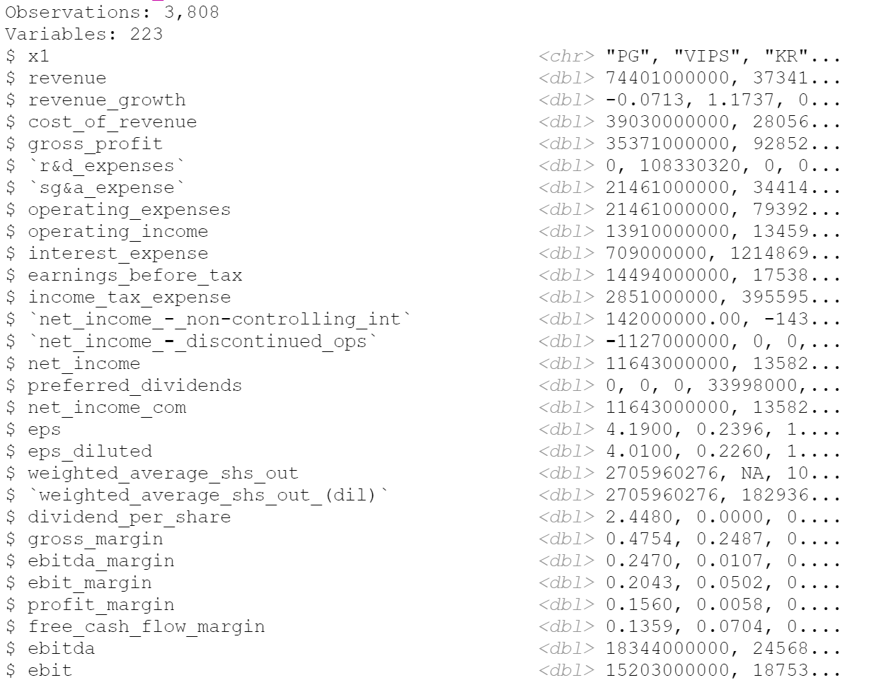

Our Dataset
Example: Year 2014
Data Source
Total 5 docs
From Year 2014 to 2018
22,077 Rows
223 Columns
Notes:
We have 5 datasets from Year 2014 to year 2018, and this is the 2014 with 3800 rows and 223 columns.

Slide 6
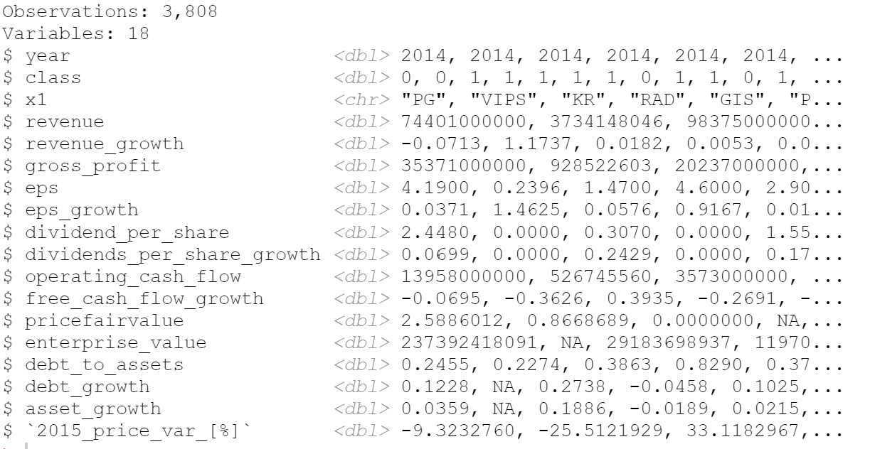
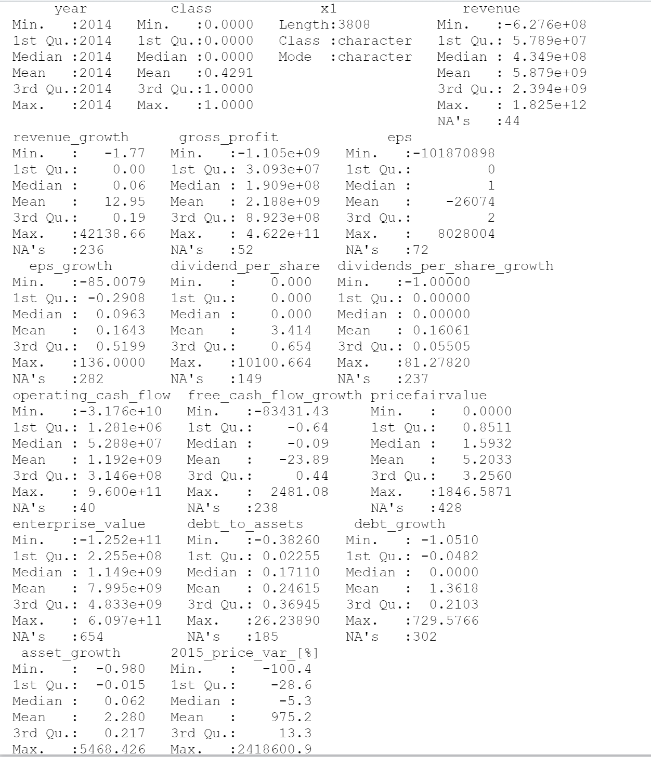
Data Cleaning
Notes:
After the data cleaning, there are 3800 rows and 18 columns.

Slide 7
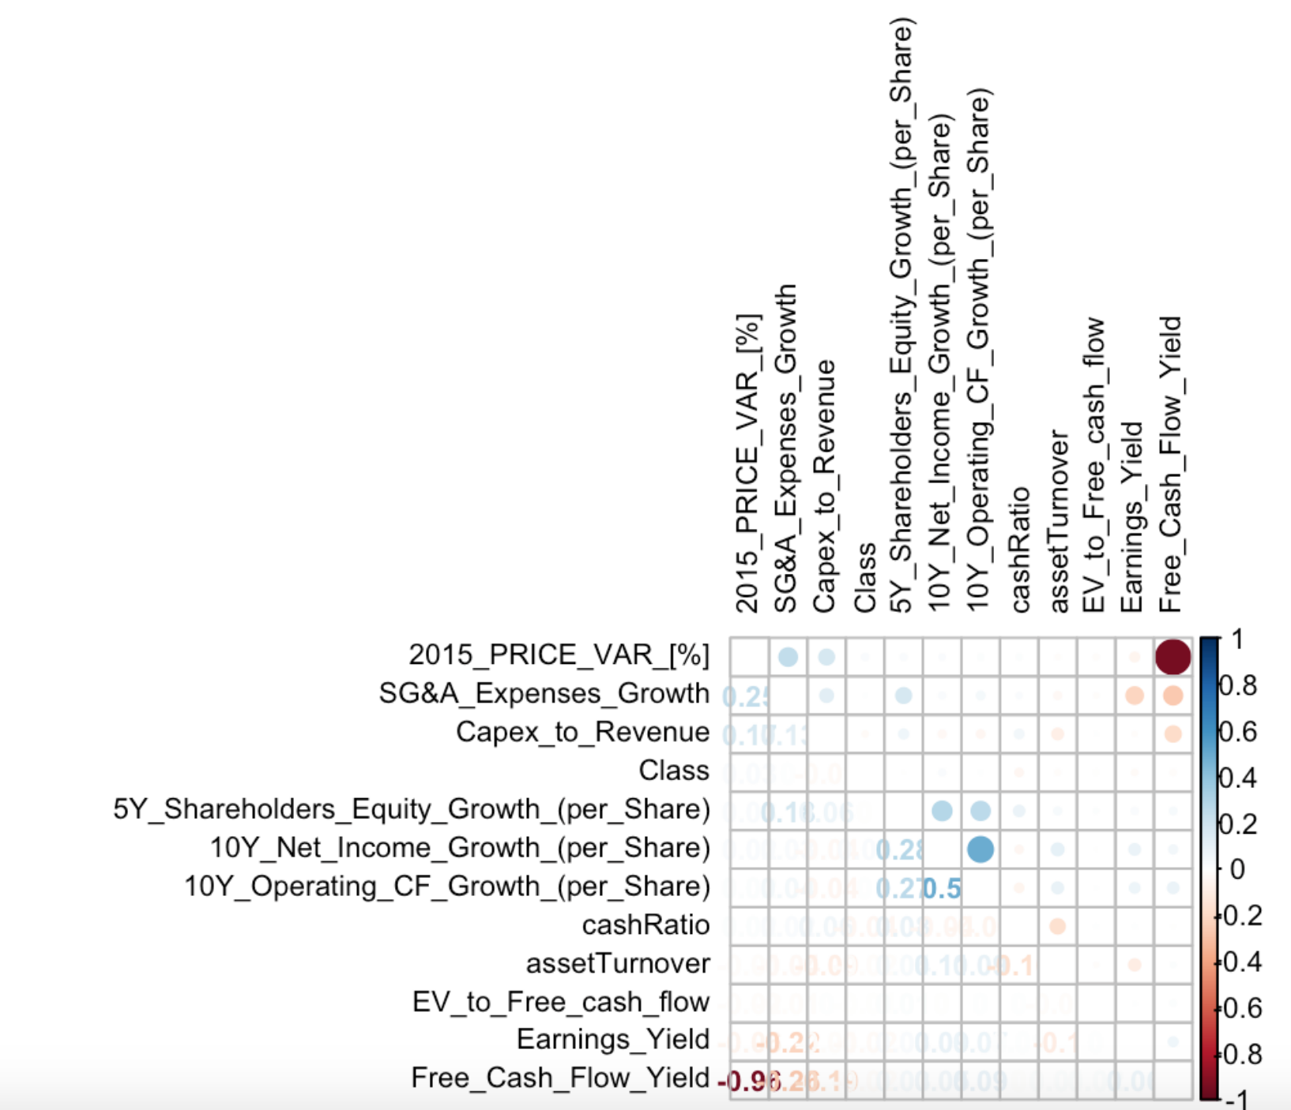
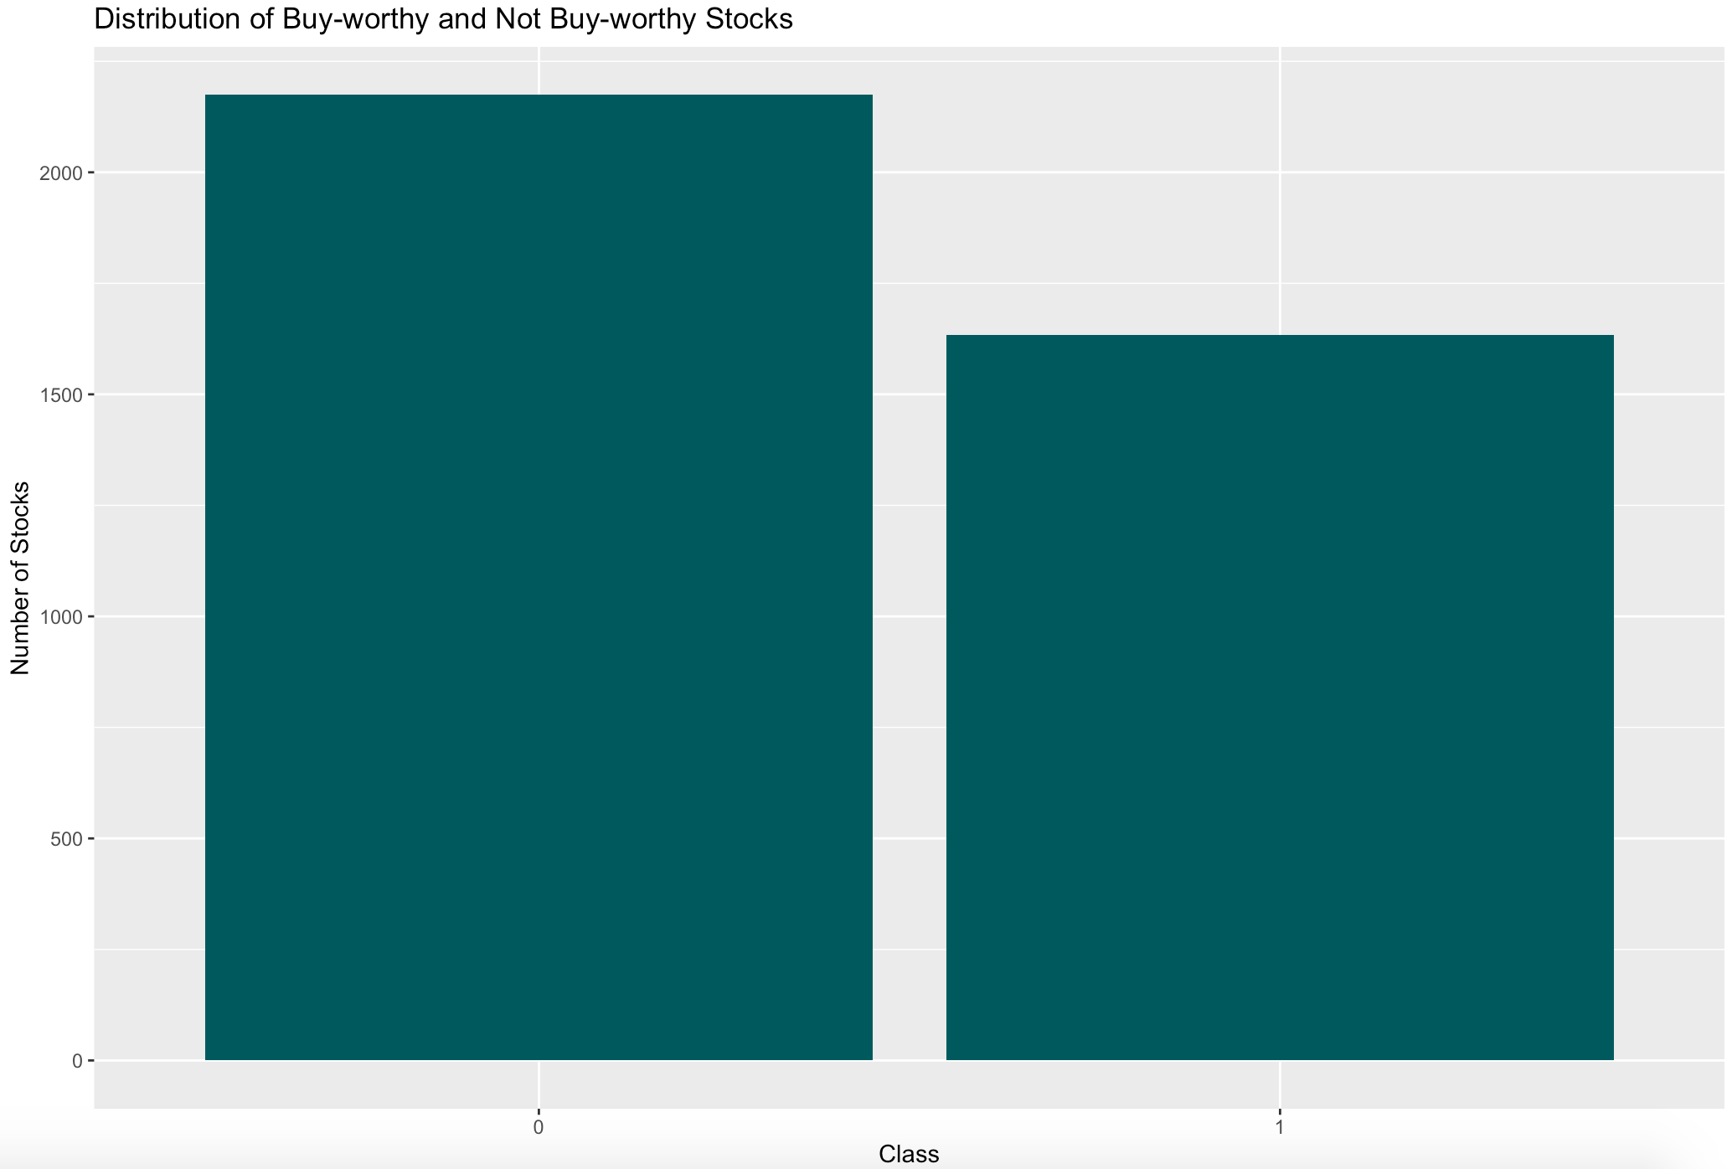
Exploratory Analysis I
Distribution of Buy-Worthy and Not Buy-Worthy Stocks (Year 2014)
The correlations between variables and price variation are not as strong as expected and needs more investigation.
Class 0-Not Buy-Worthy Class 1-Buy-Worthy
Class 0:
2174
(57%)
Class 1: 1634
(43%)
Notes:
Kiki

Slide 8
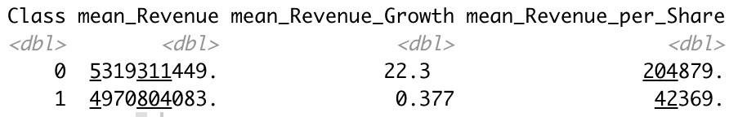
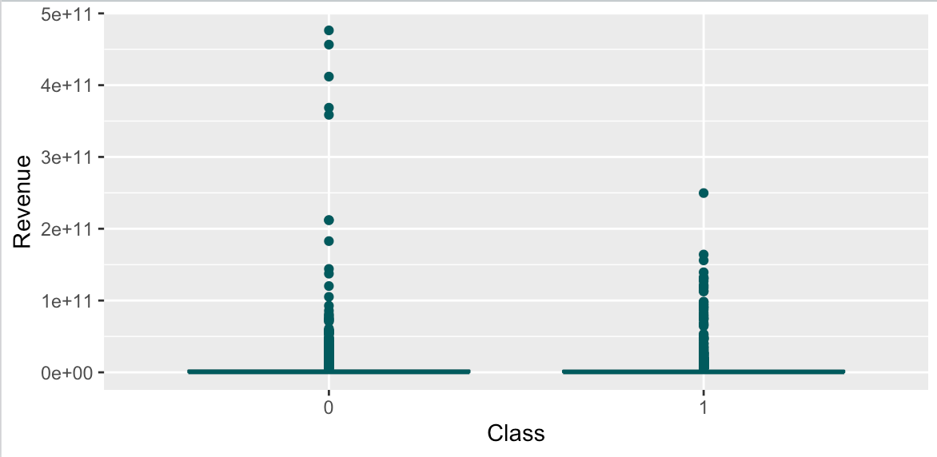
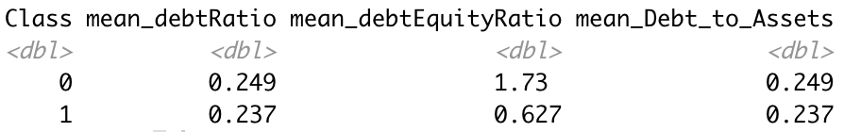
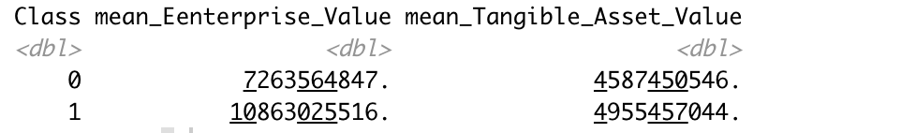
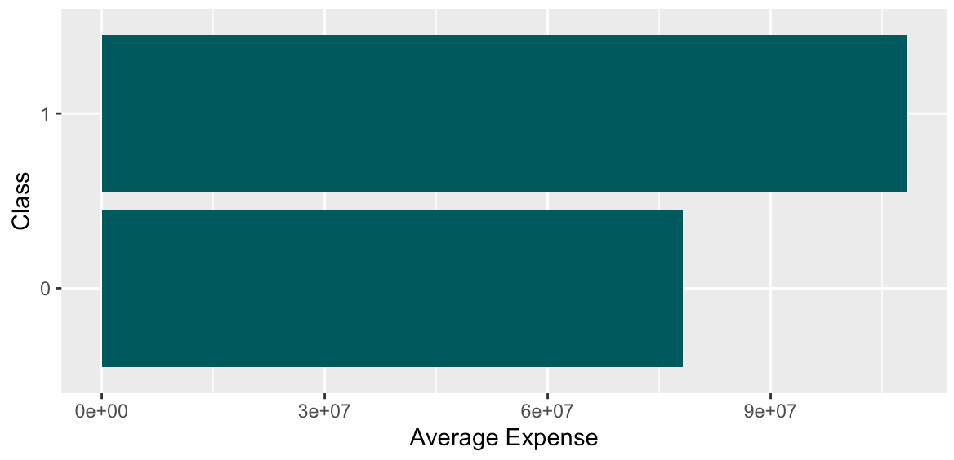
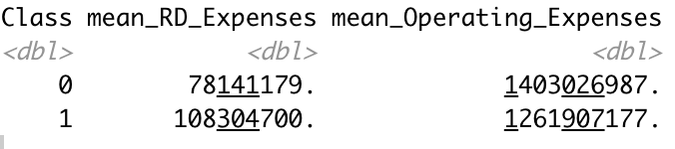
Exploratory Analysis I
Some insights about key variables
Notes:
Kiki

Slide 9
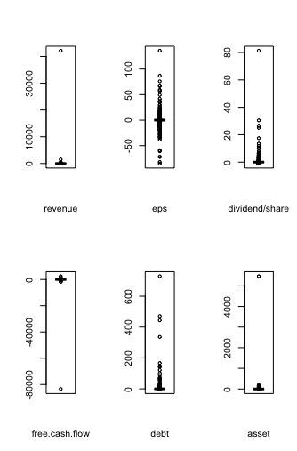
Exploratory Analysis II
Boxplots of growth
Mean of Growth
Revenue | 12.95424
Eps | 0.164305
Dividend/share | 0.1606129
Free cash flow | -23.89264
Debt | 1.36178
Asset | 2.279999
Determine outliers:
Interquartile Rule
MOMC
Notes:
Since we just got our dataset yesterday, we haven’t decided whether we delete outliers or not. As we can see from this boxplot, under each variable there is a extreme value which we may consider as an outlier. Those outliers may affect our analysis, but we may try to use interquartile rule or other rules based on our analysis to determine the outliers. For the table, is the mean of growth of those variables and all those values are contributed by these extreme values. But we may have a deep looking in our future analysis.

Slide 10
Exploratory Analysis III- SECTION RECOMMENDATION
11 Sectors:
Less than 300: 6 sectors
More than 500: 5 sectors
(Less than 100- Utilities and Communication Service): Overfitted
Peaks appears in:
Consumer Defensive
Basic Materials
Healthcare
Consumer Cyclical
Real Estate, Energy
Financial Service
Technology
Notes:
Kiki

Slide 11
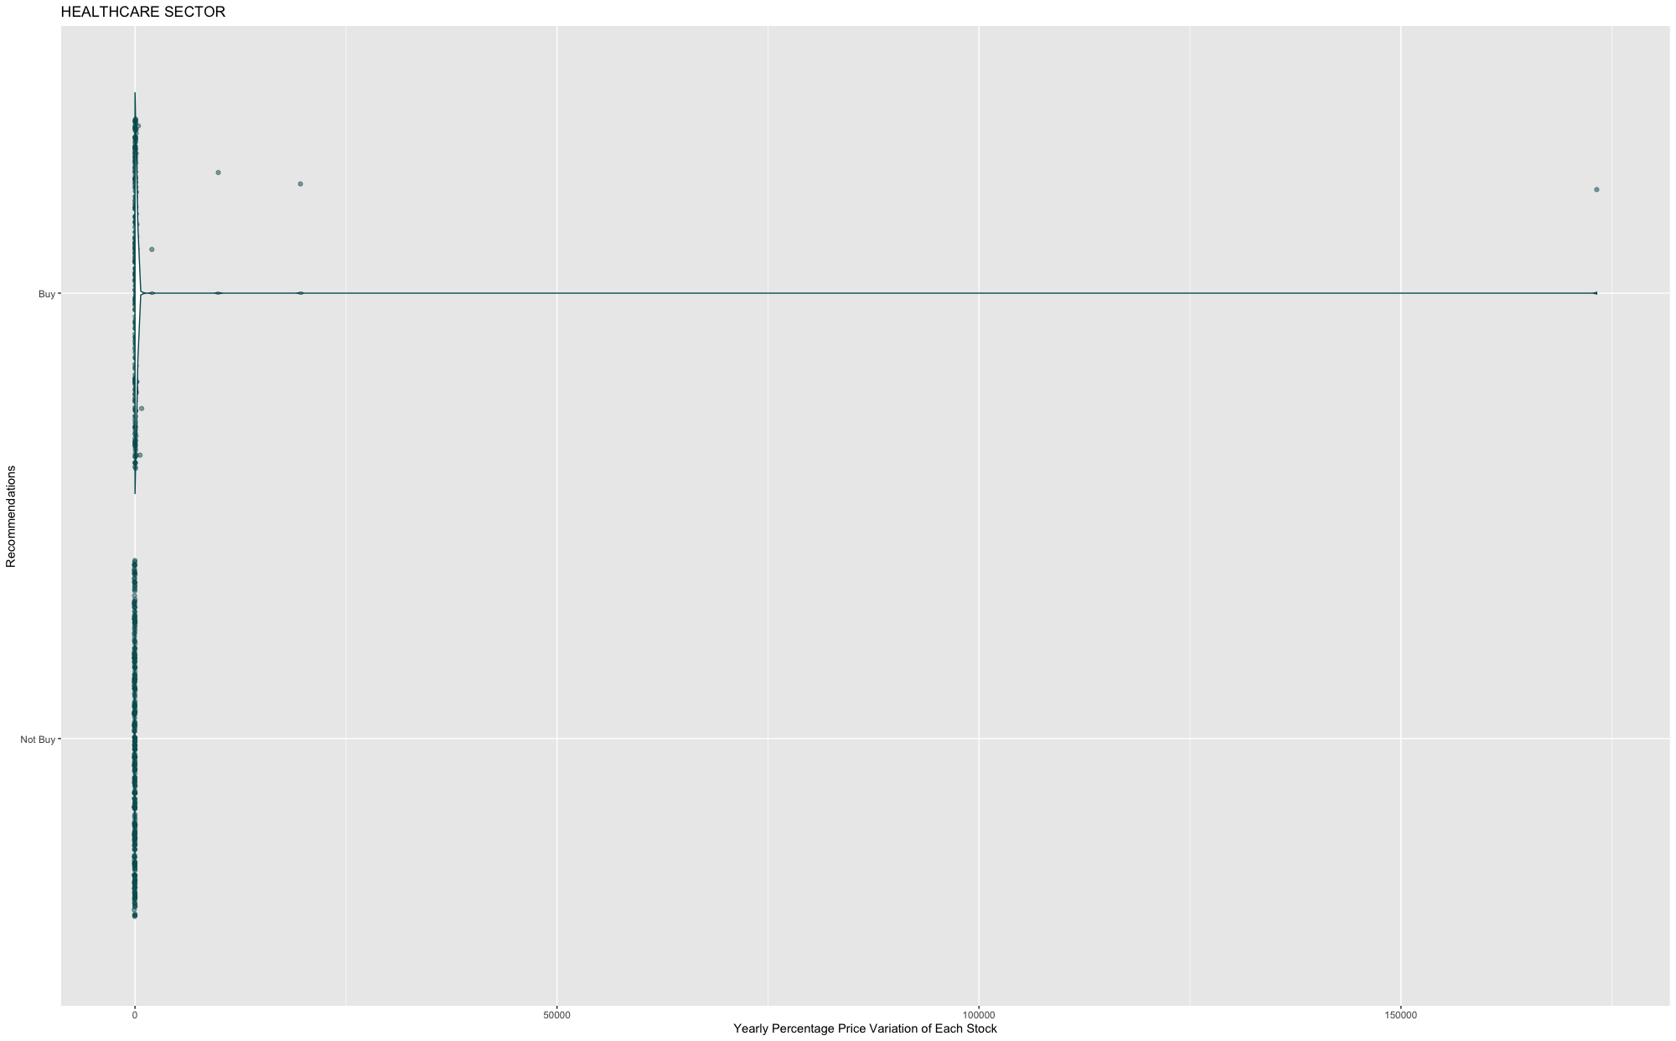
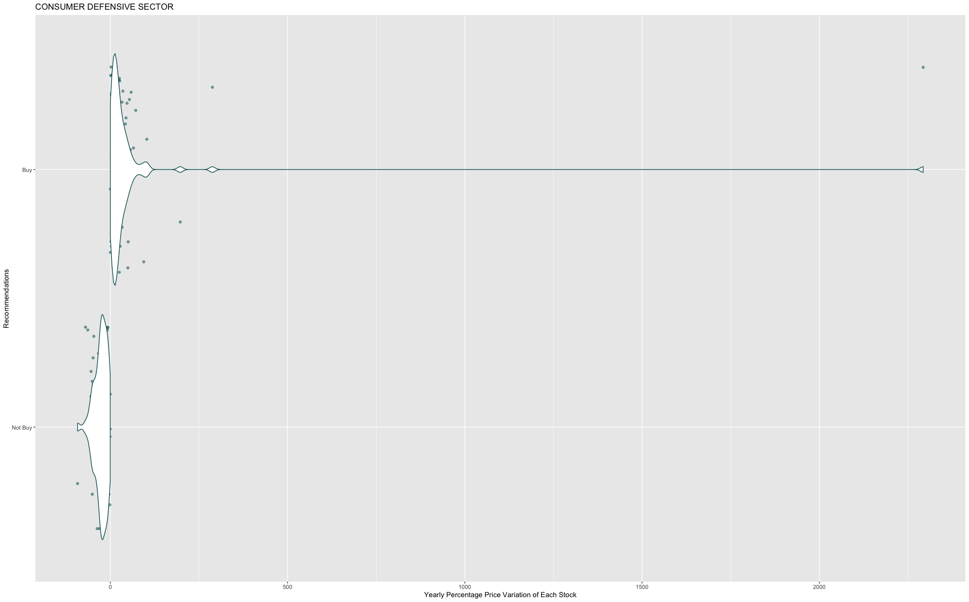
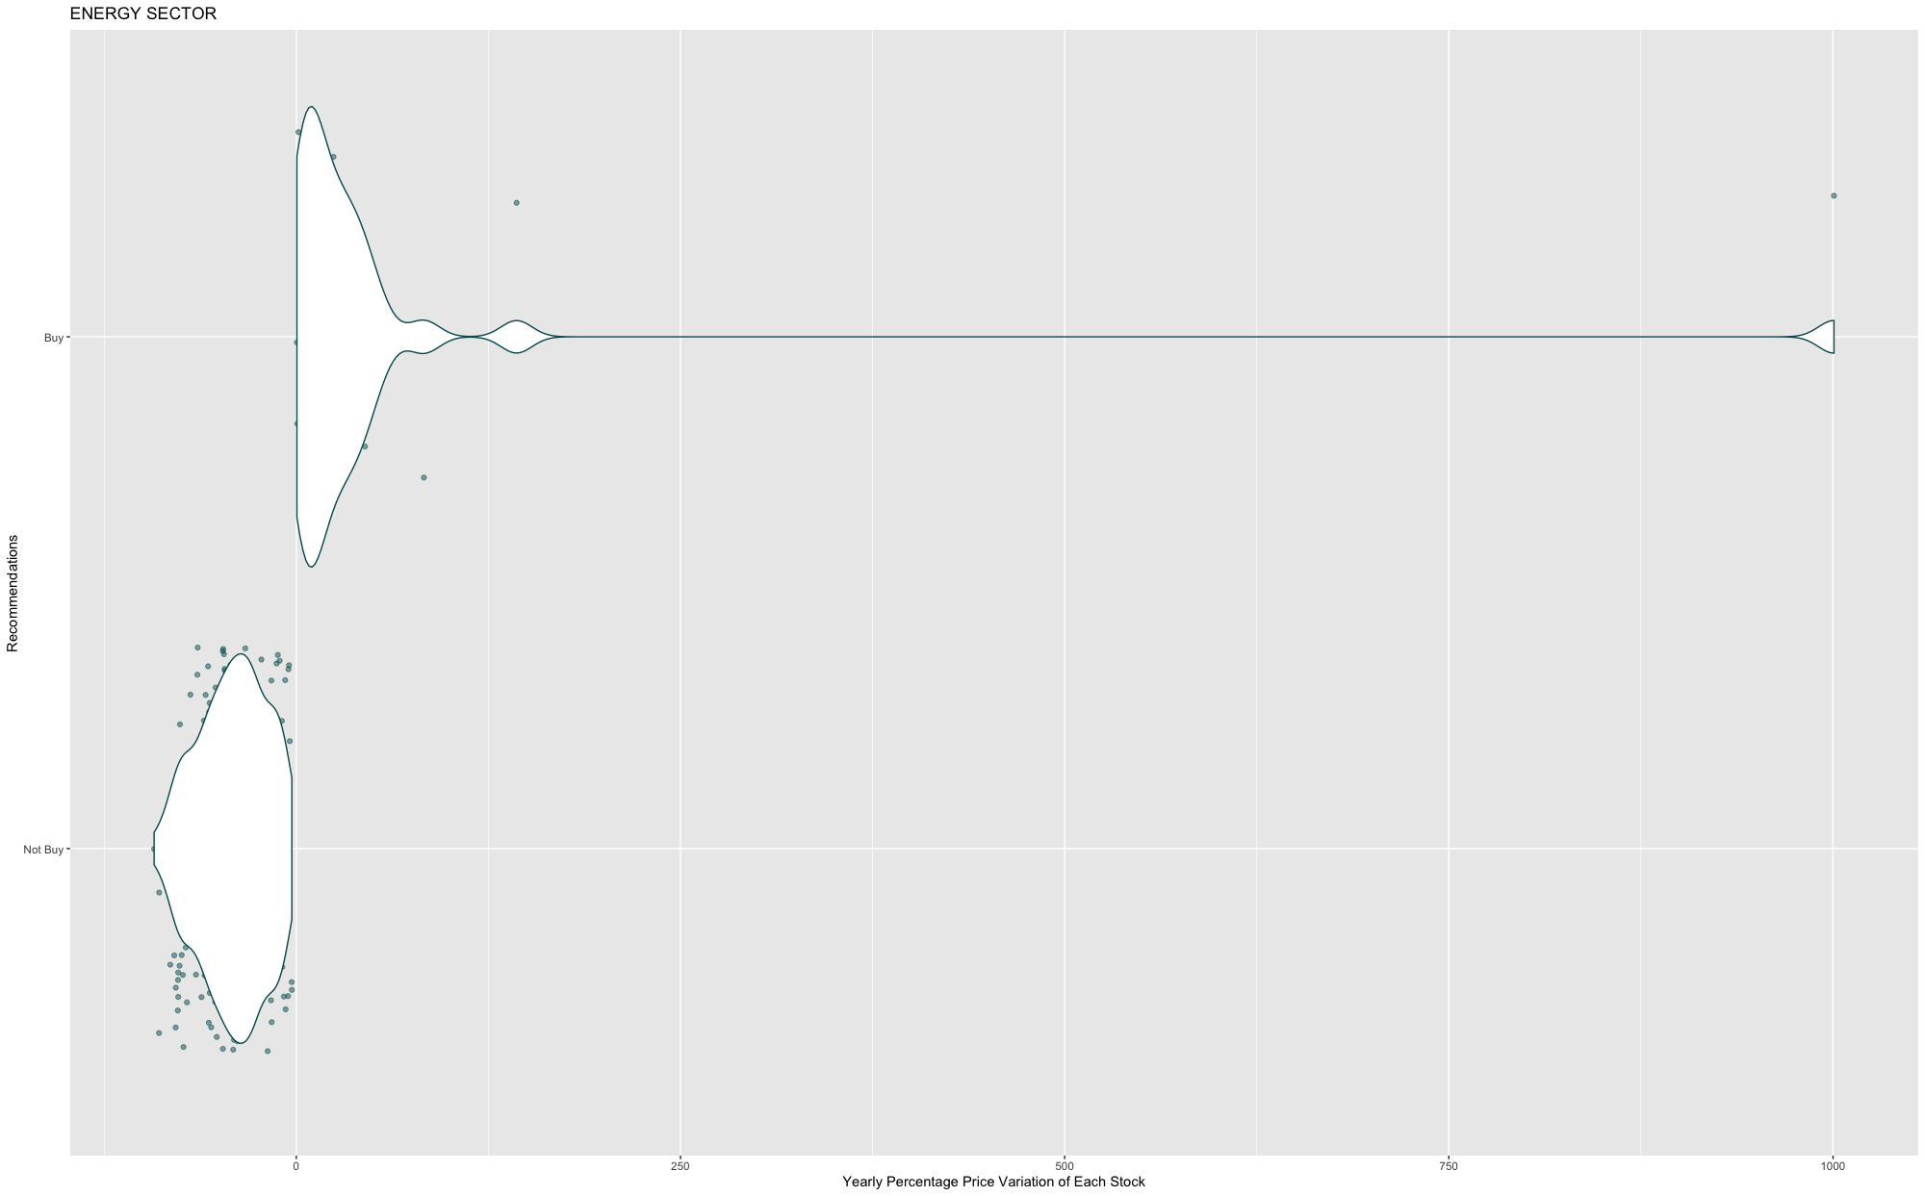
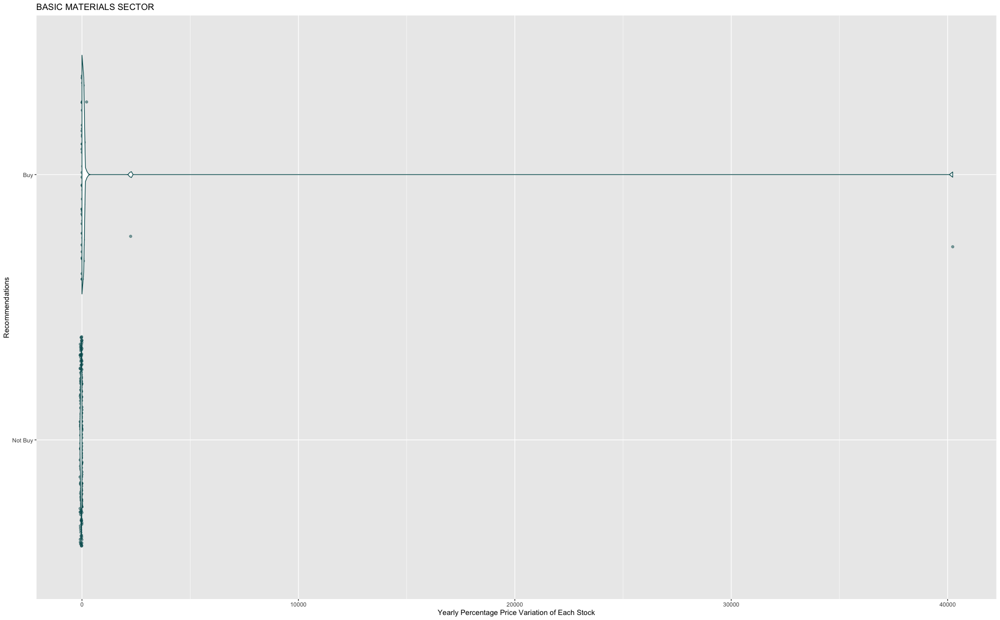
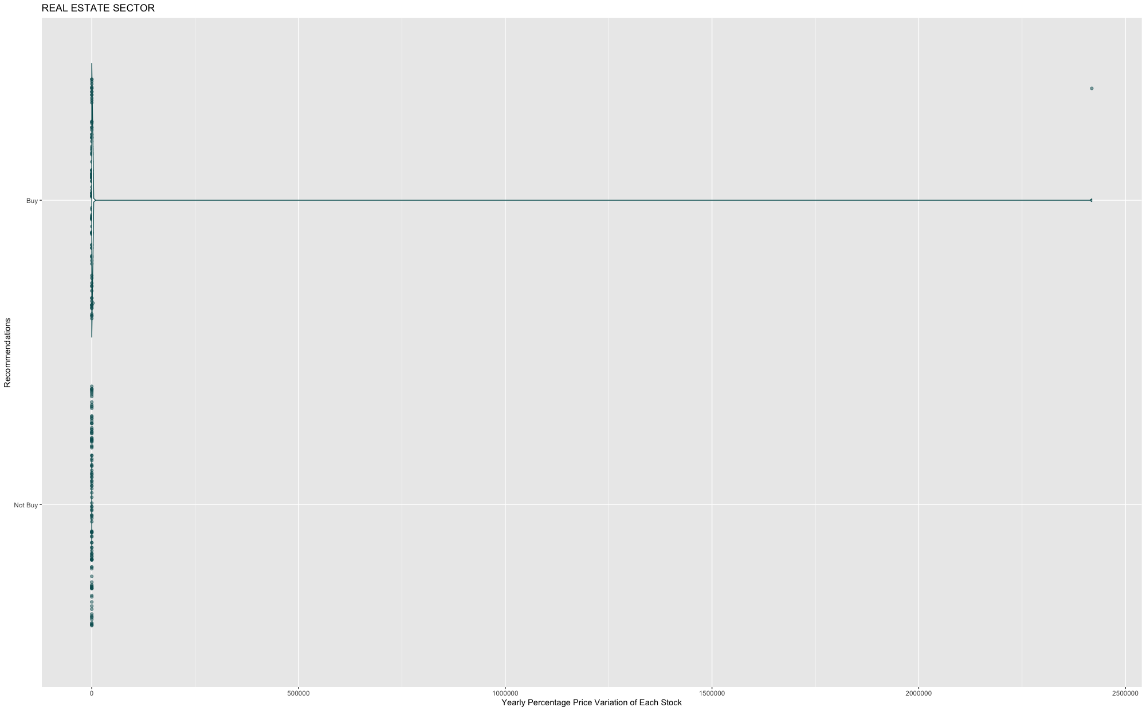
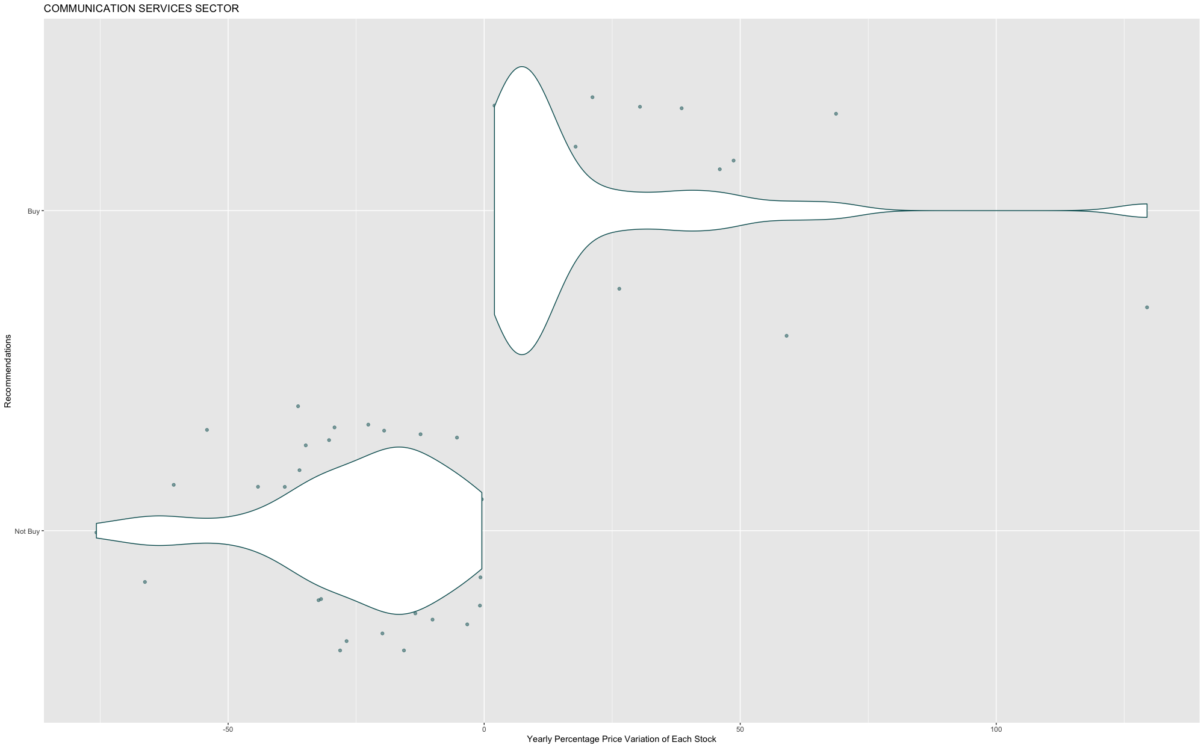
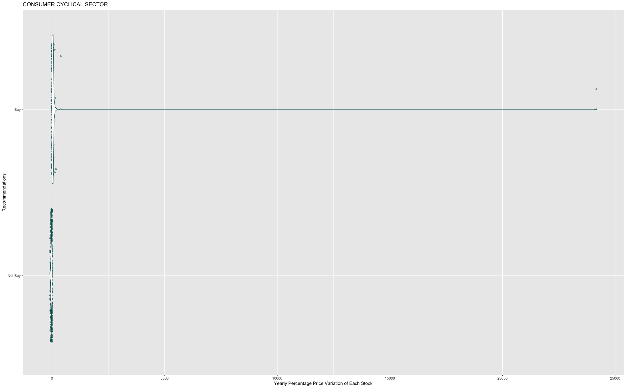
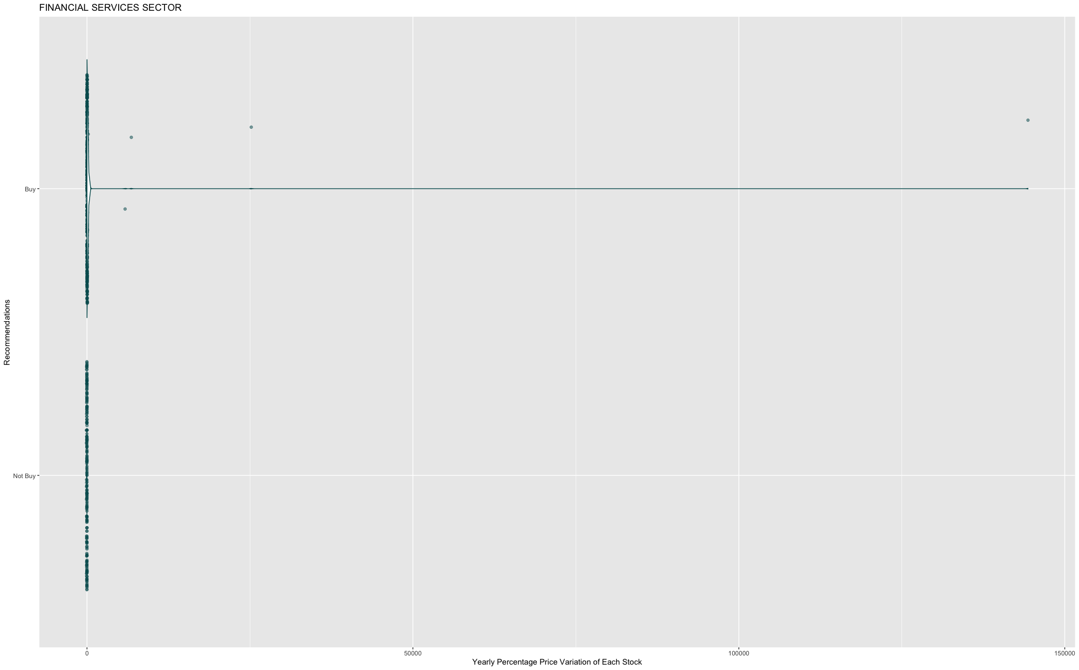
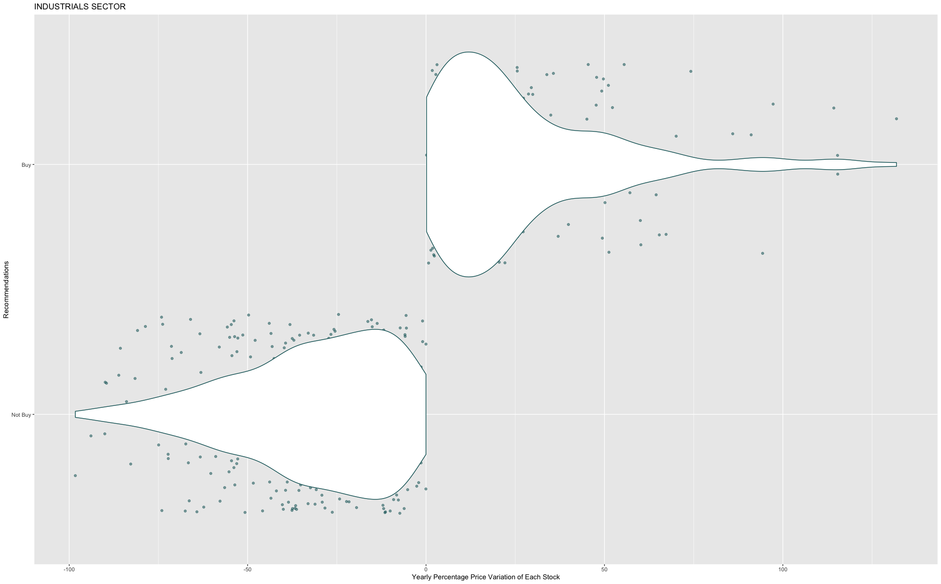
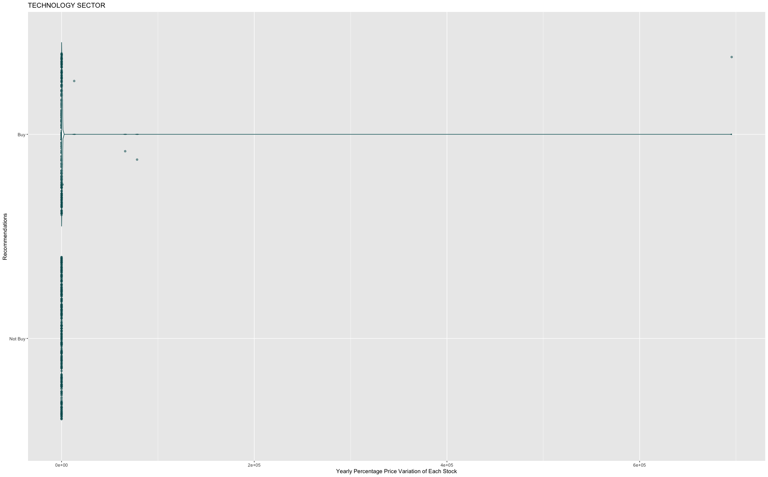
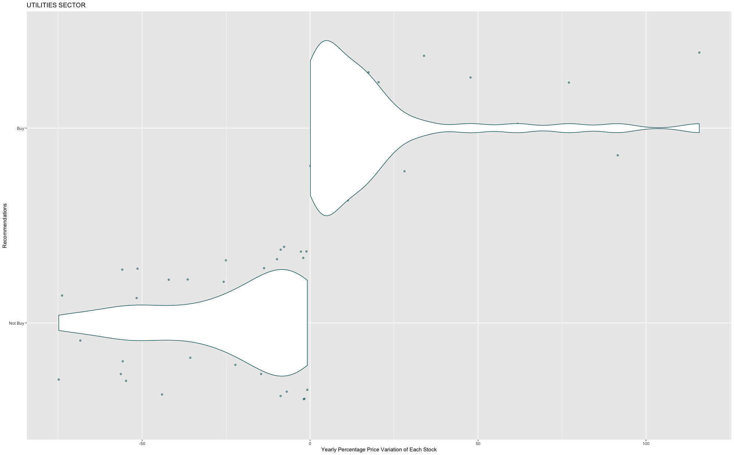
Exploratory Analysis III- SECTION RECOMMENDATION
Notes:
Kiki

Slide 12
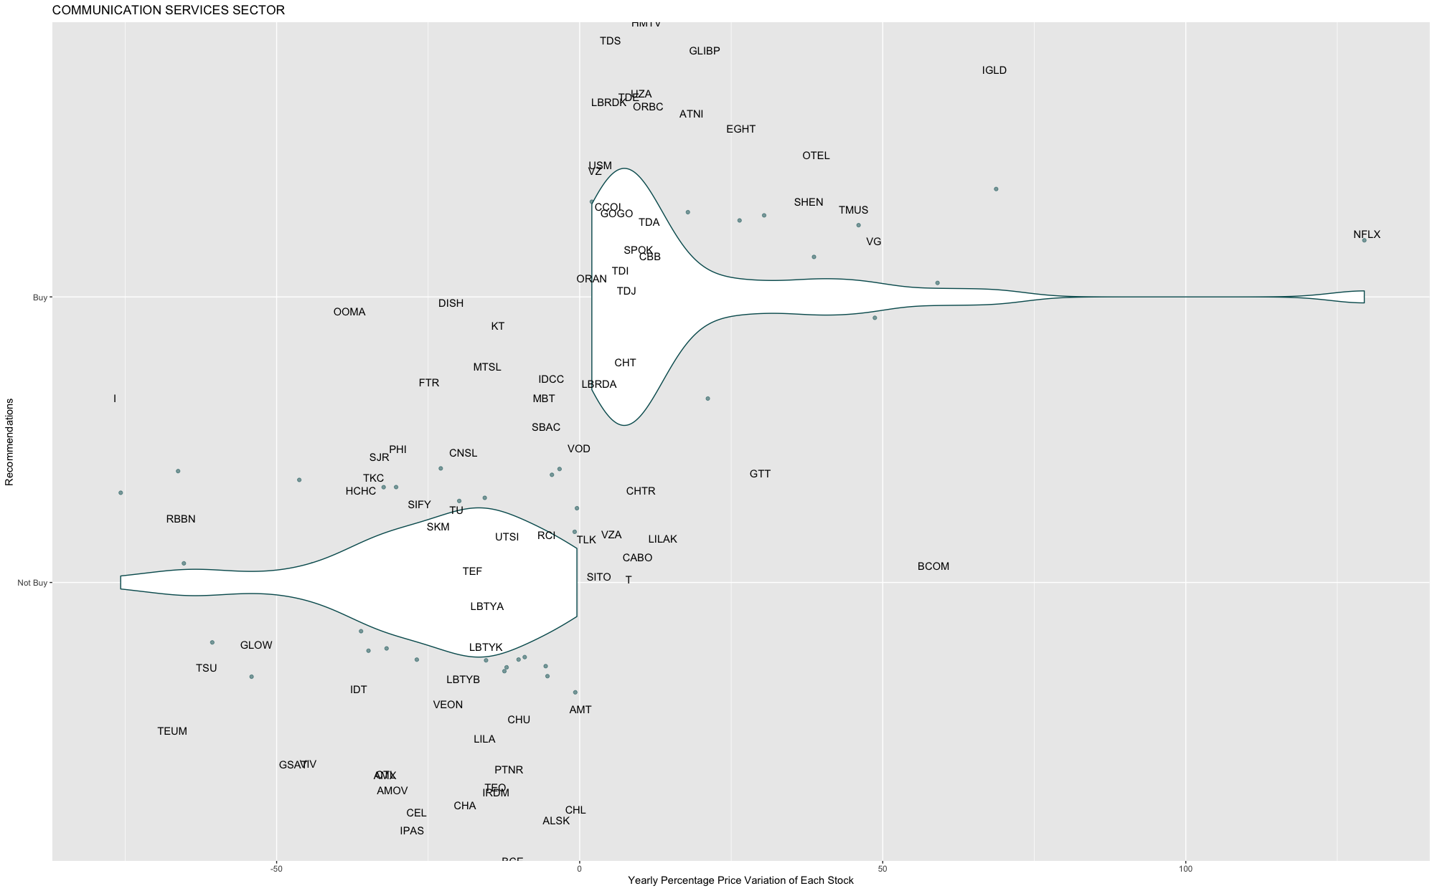
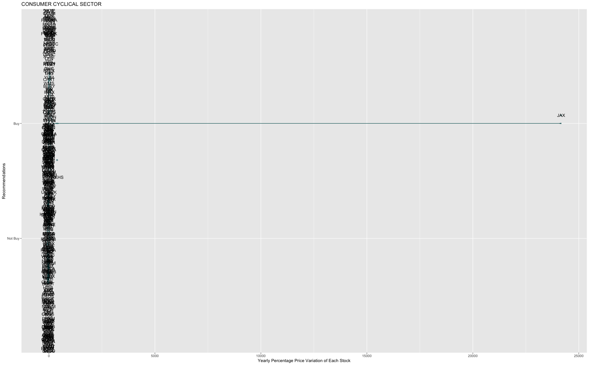
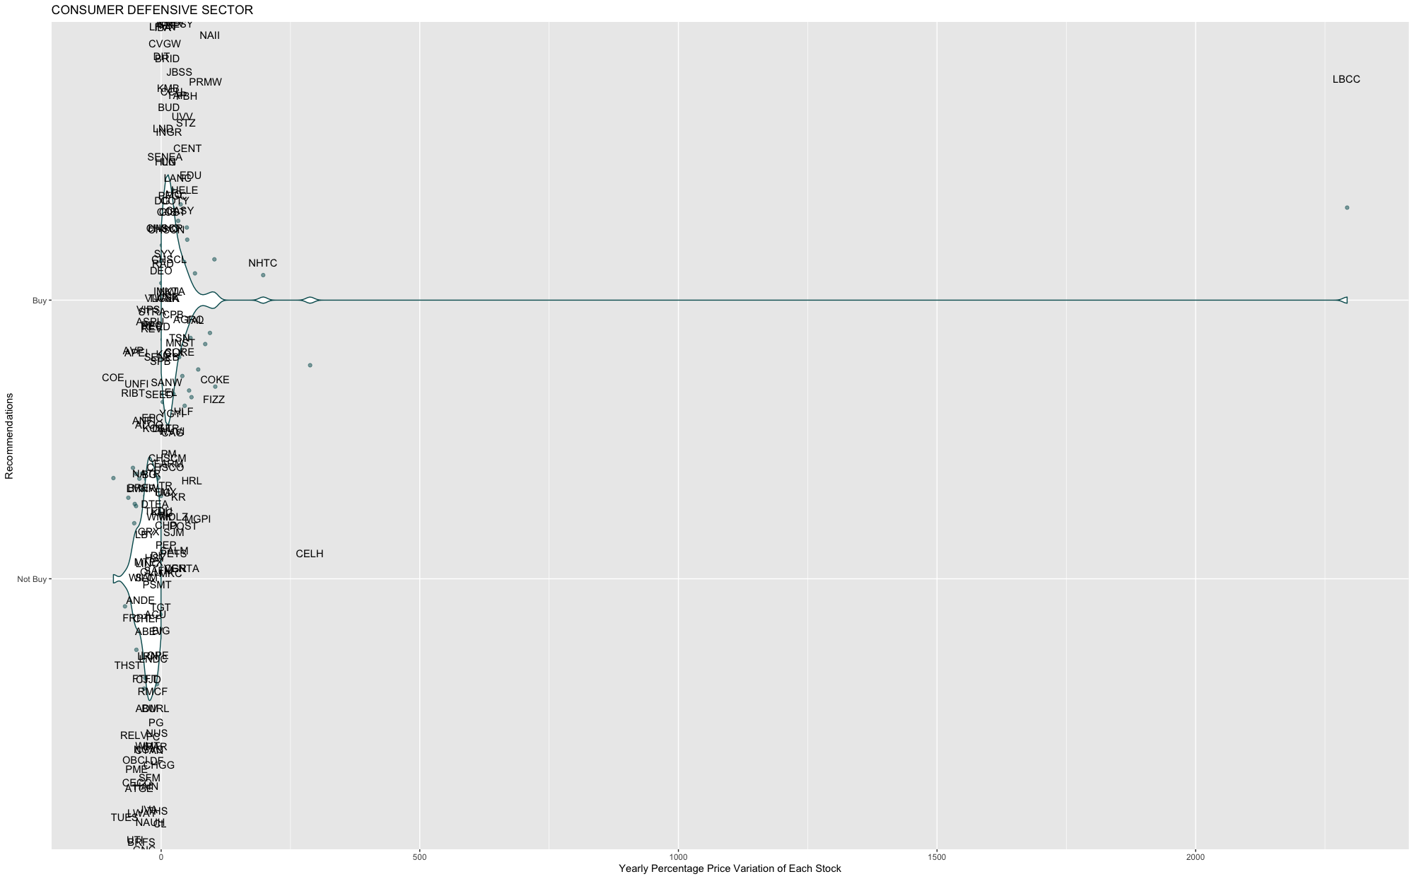
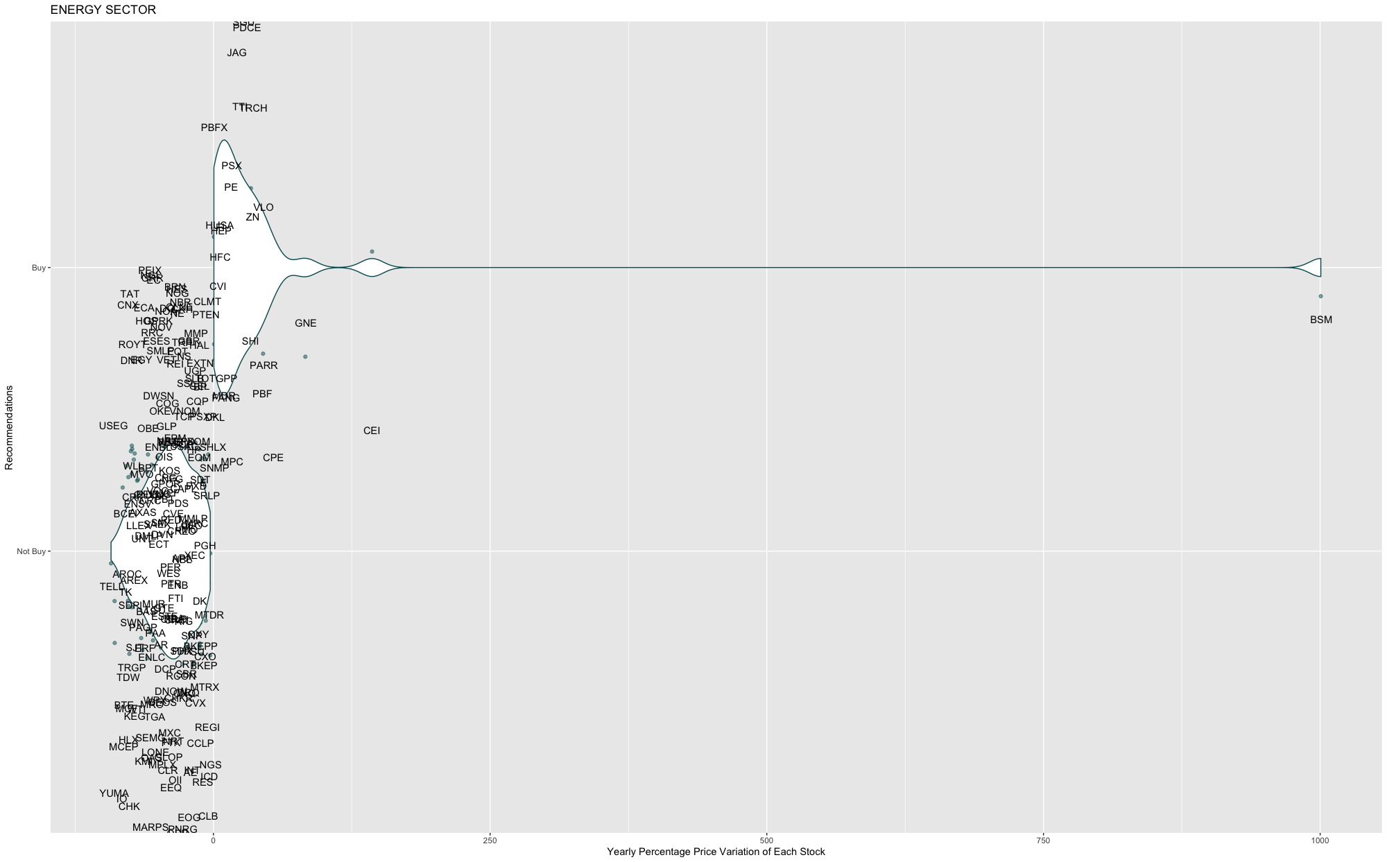
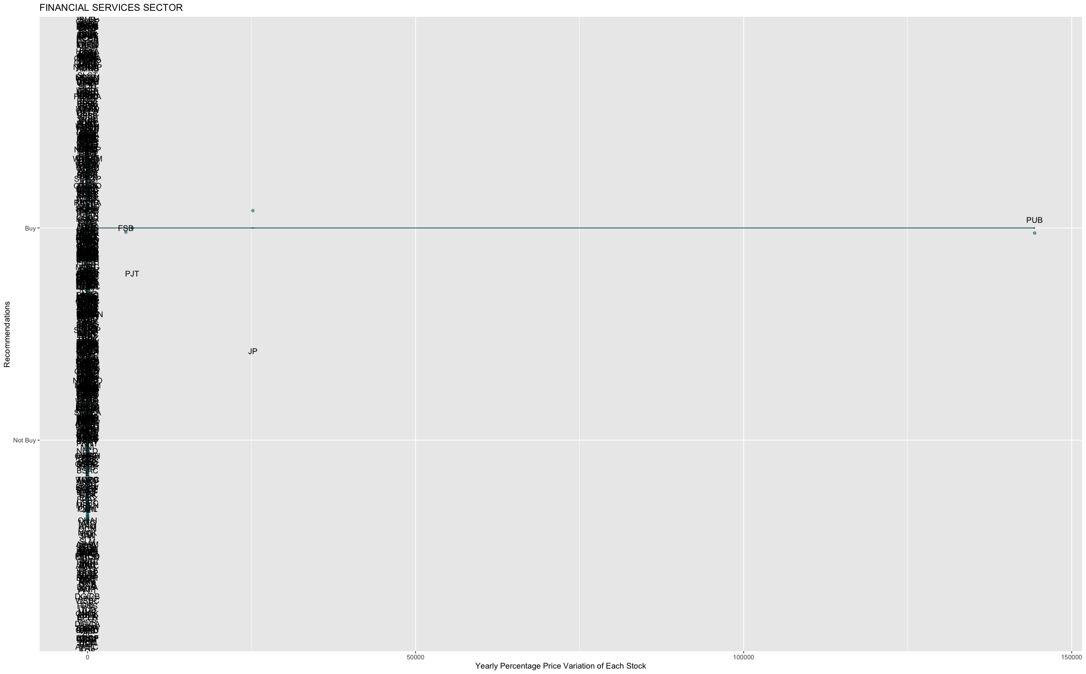
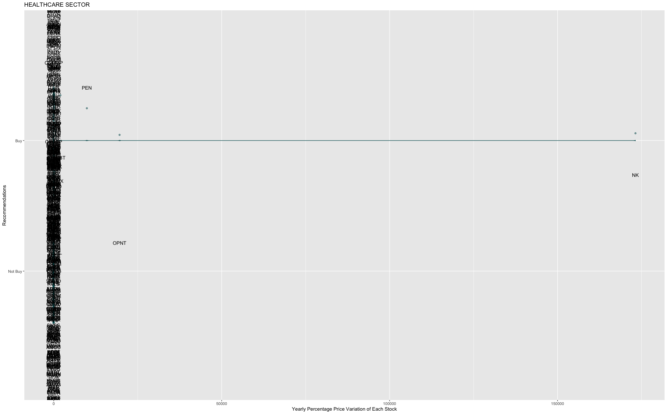
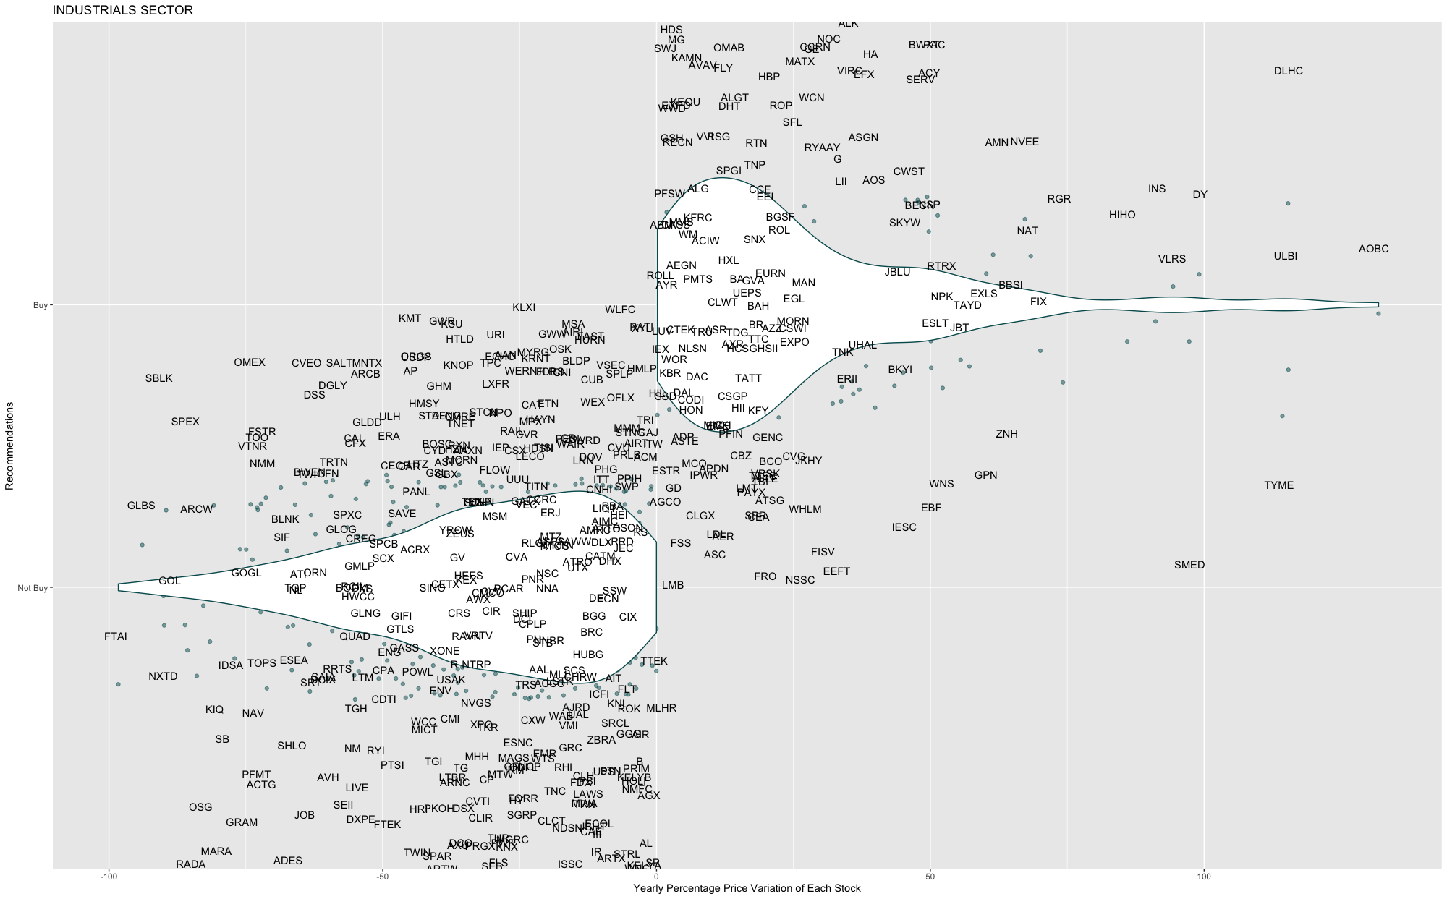
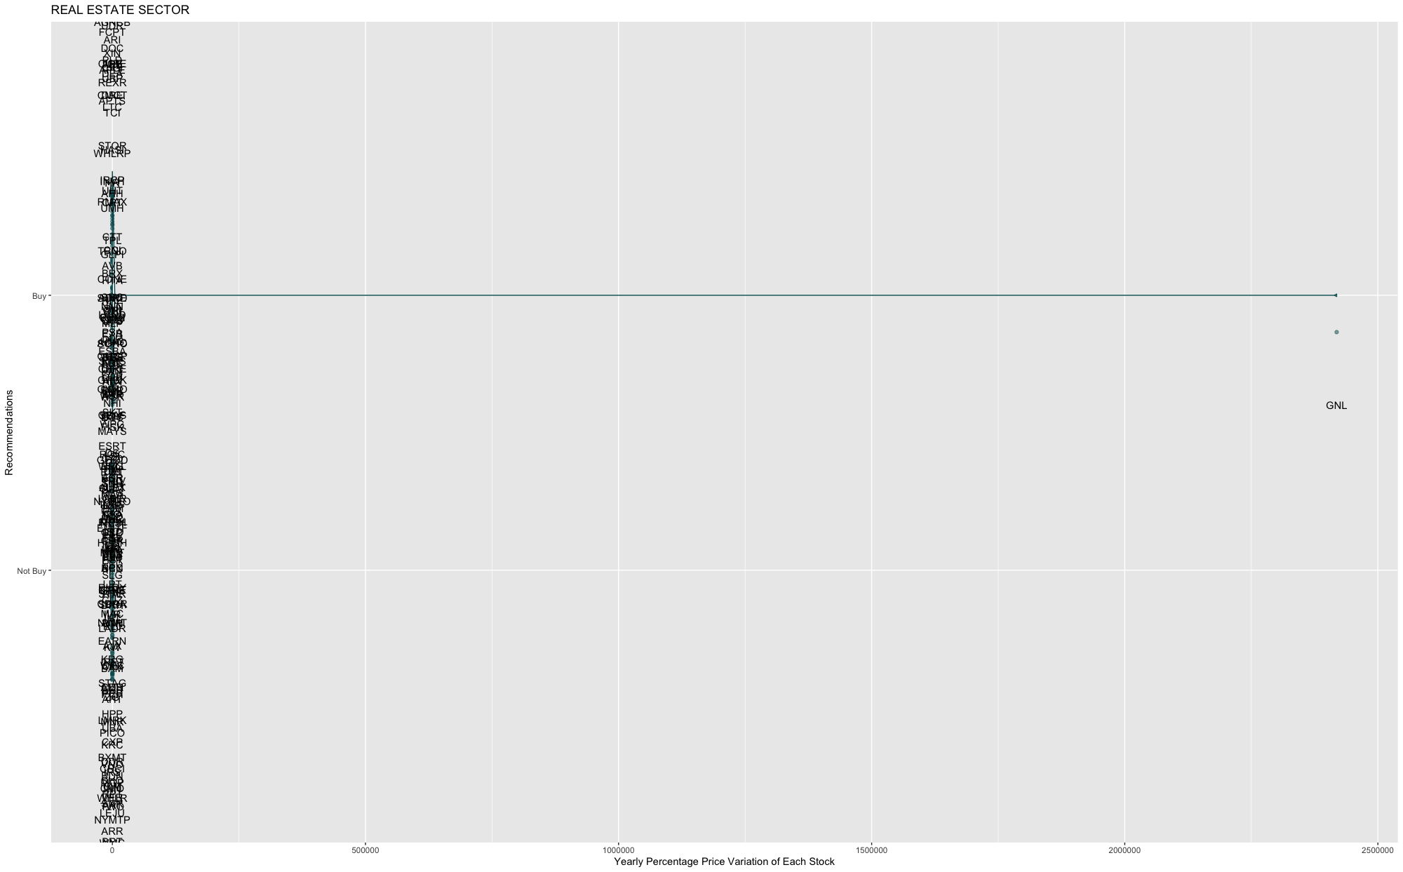
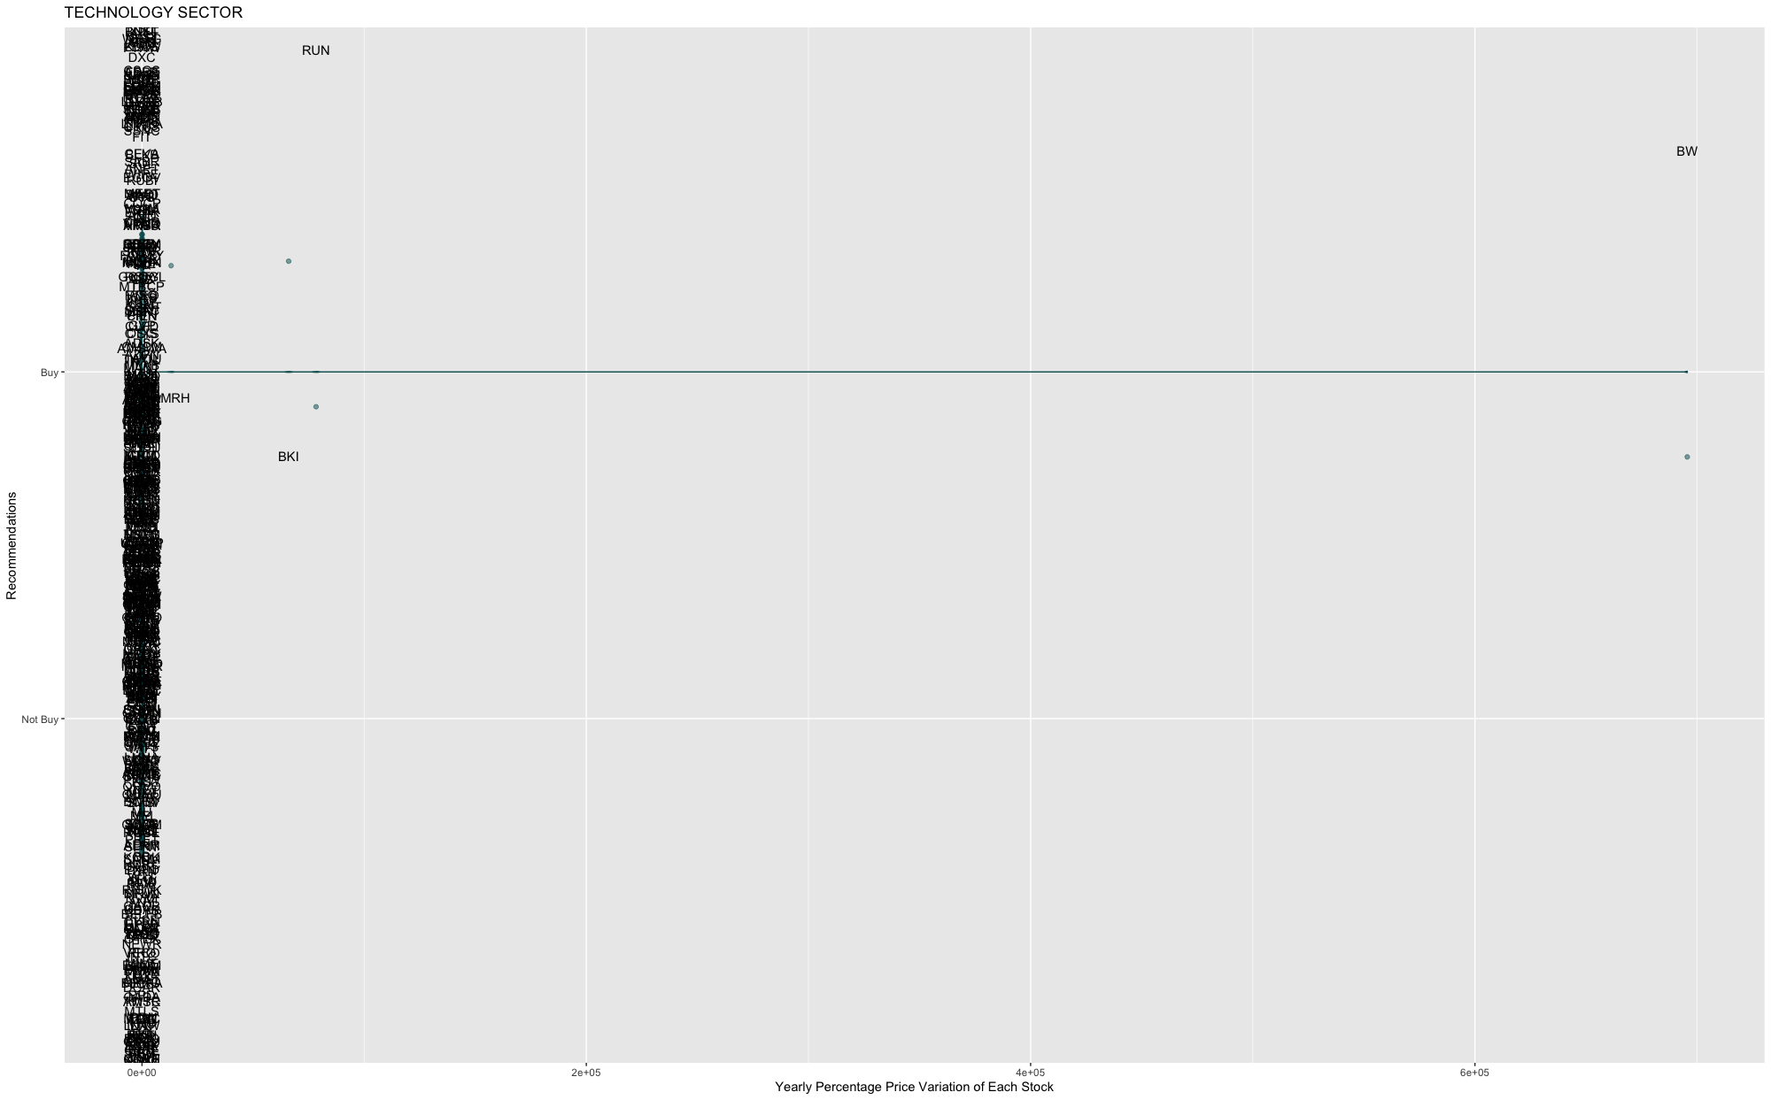
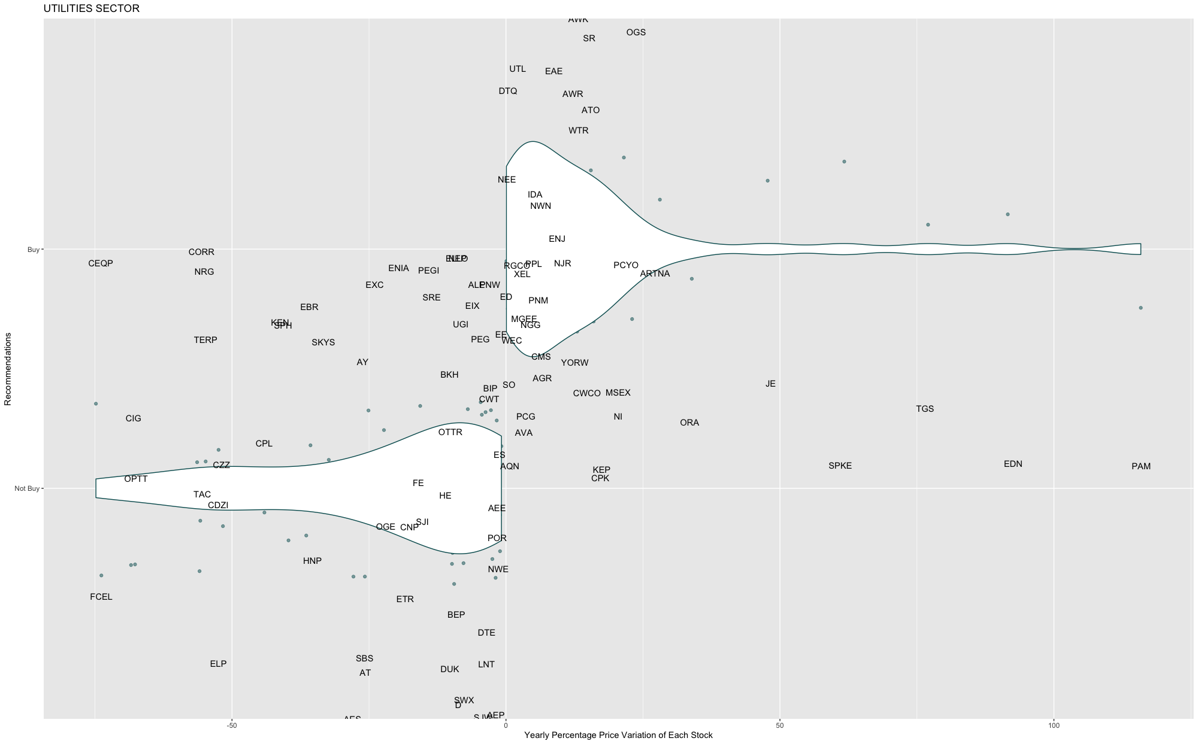
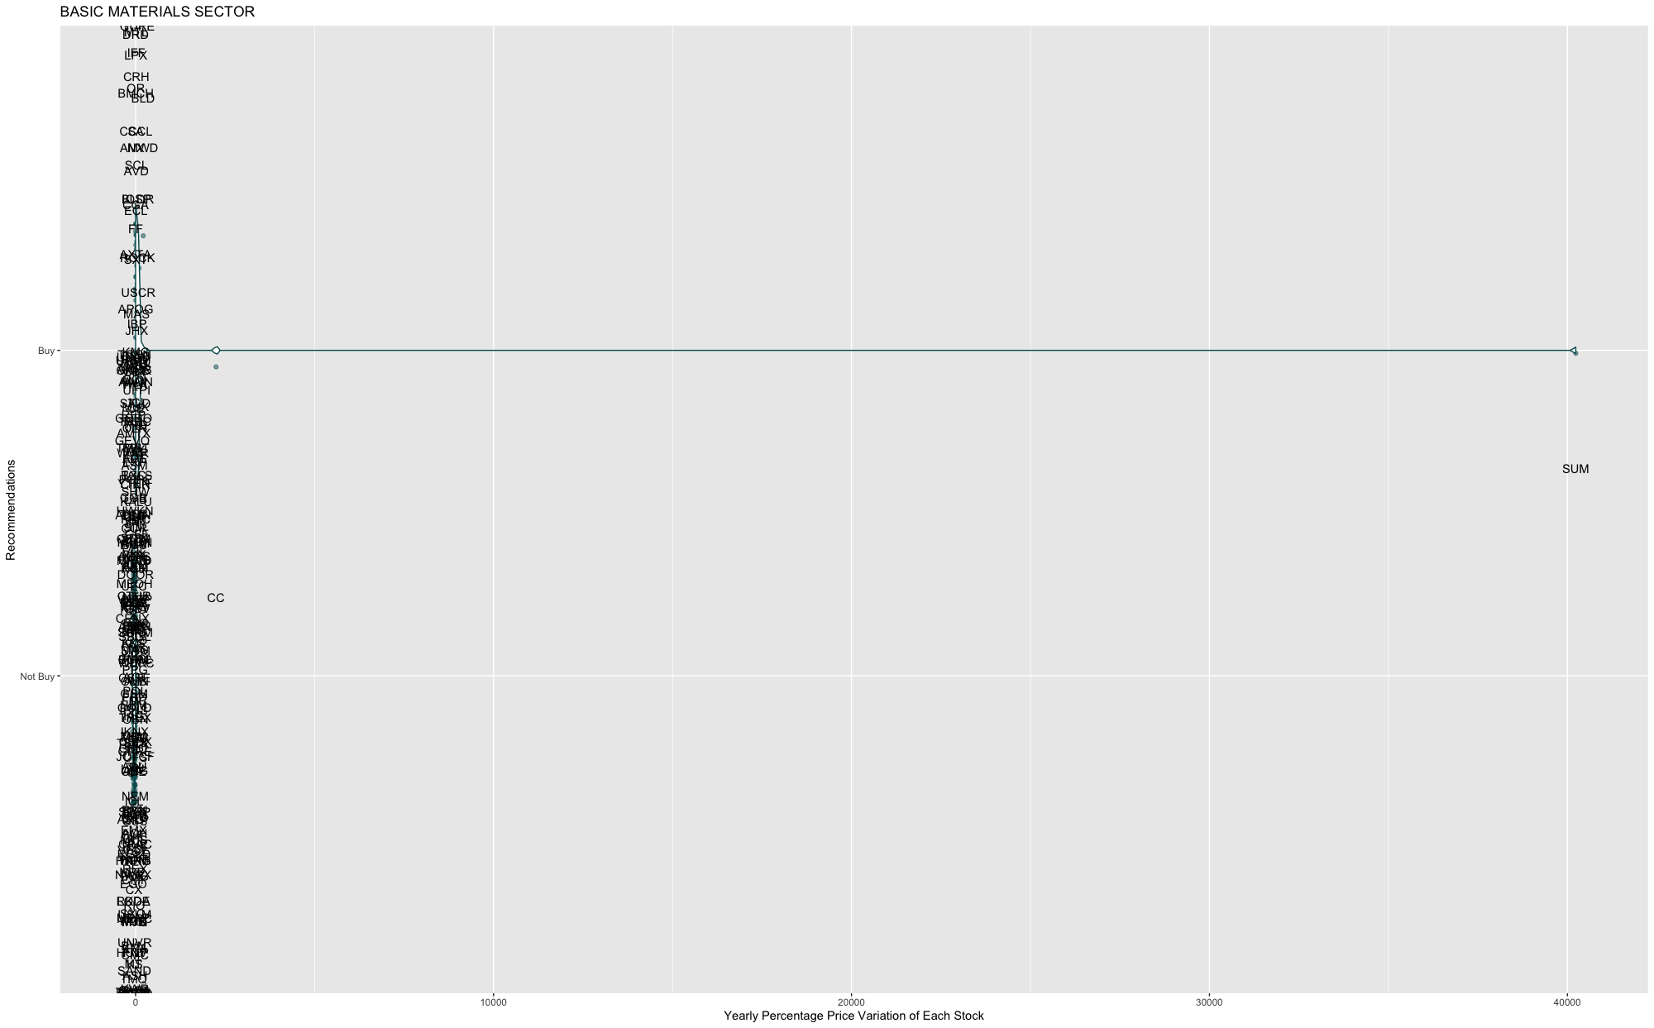
Exploratory Analysis III- SECTION RECOMMENDATION
Notes:
Kiki

Slide 13
Challenges and Concerns
Data Cleaning: NAs and Outliners
Merging Different Years (2014-2018)
Lack Background Information

Slide 14
THANKS
Do you have any questions?

